Slide 1
Phonepe Pulse Insights
Presented By
Manisha Priyadharsini M

Slide 2
Tools & Technologies Used
VS Code:
Cloning data from github to local
Python:
Processing and data Cleaning
Database Management:
Integrating Python and SQL (Structurized format) via SQLAlchemy
Visualization:
Data Visualization via Streamlit

Slide 3
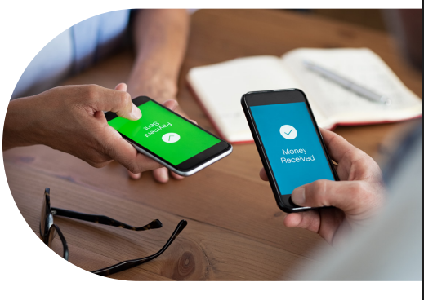
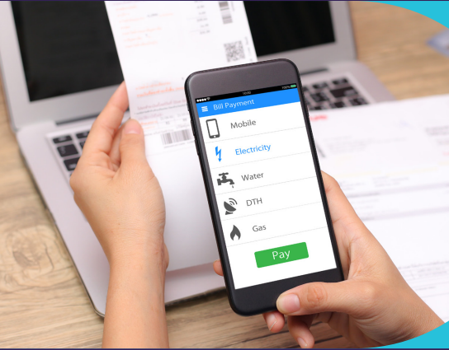
Transaction
P2P Payment
Merchant
Recharge and Bills
Financial Services

Slide 4

Insurance
Partnerships
Accessibility in Non-Metro Areas:
Consistent Increase in Tier 2 and Tier 3 cities
Increases Over the Years But not as good as Transactions

Slide 5
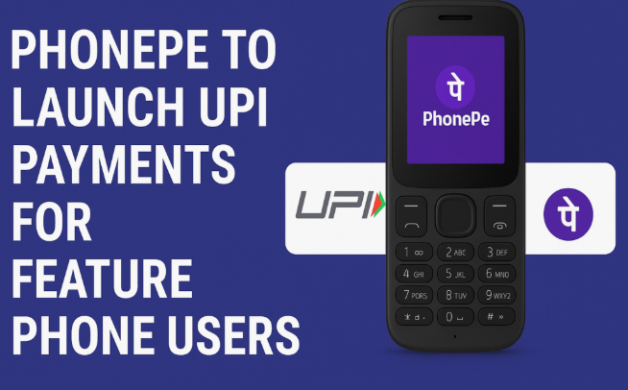
Device Usage Analysis
Driving Smartphone Adoption
Catalyst for Localized Innovation
Google Play Store and
Apple's App Store.
homegrown App

Slide 6
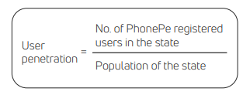
User Registration Analysis
Rapid Increase in Registrations
Rural and Urban
140 million daily active users.
20 transactions.
Web-crawling

Slide 7
User Registration Analysis
Title
Rural and Urban
Title
Title
Web-crawling
Rapid Increase in Registrations
Presentations are communication tools that can be used as demonstrations.
140 million daily active users.
20 transactions.
Presentations are communication tools that can be used as demonstrations.

Slide 8
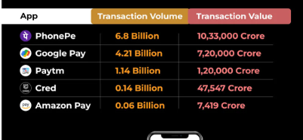
App Opens
Speed and Wallet Functionality
Broader Services
Rewards
Market Penetration

